Slide 1
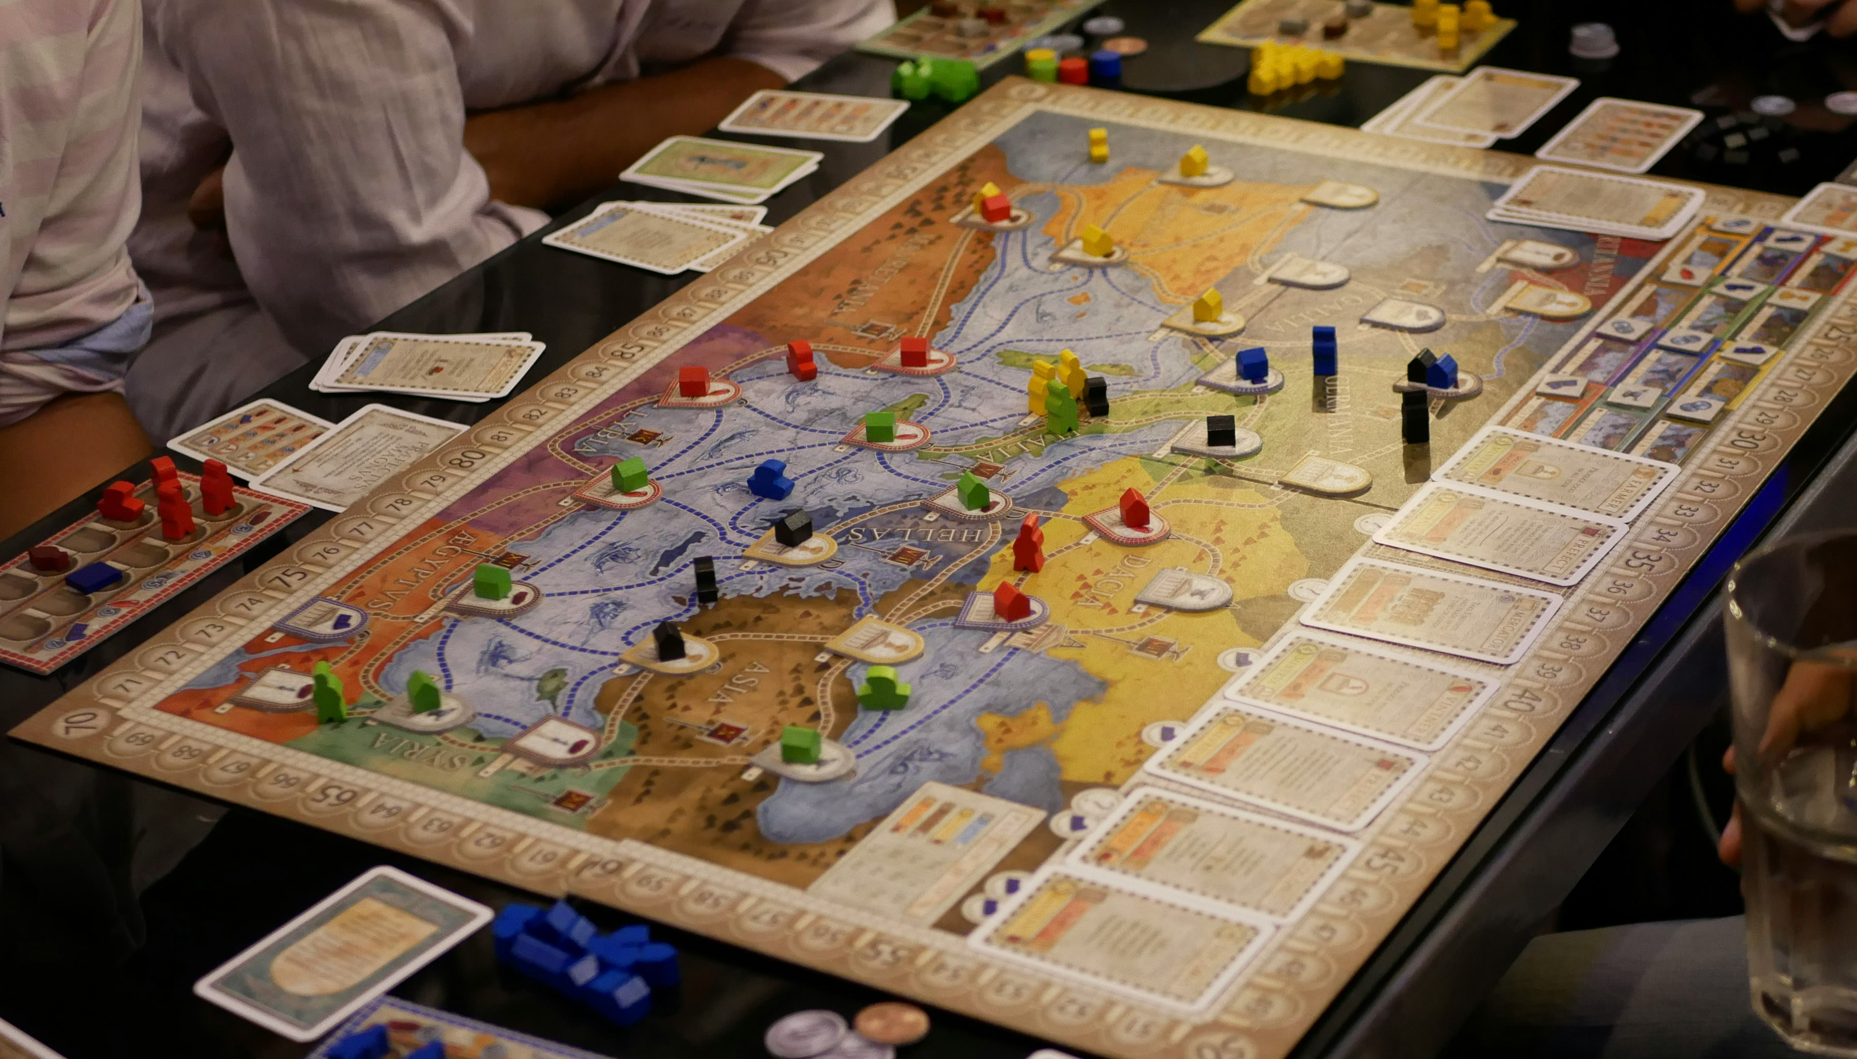
Paralegal Team
Playbook
Mentoring and file standards for the team
Jane Sparks, Senior Paralegal | Hartwell and Greer

Slide 2
The playbook
1
How the work is shared
2
File standards everyone follows
3
Naming and versioning
4
Deadline discipline
5
The growth path

Slide 3
How the work is shared
Jane leads the harder files; the juniors carry steady volume

Slide 4
The standard, and where the team is
Standard | What it means
Folder skeleton | Same sections on every matter, day one
Naming convention | One convention, used by everyone
Versioning | Date stamp drafts, never overwrite a filing
Second read | Every filing gets a second-read pass
Hand-off | One-line status, not a roll call
Team progress
Files meeting the standard
90%
Kelsey adoption mentoring
70%
Mentoring Kelsey is part of her promotion path.

Slide 5
One team, one standard
Good habits, repeated, are what scale across every matter.

